Slide 1
Punctuation
And their types

Slide 2
GROUP MEMBERS
SYEDA ALISHAH
JANEES ASGHAR
SADIA
MAHNOOR KHALID
AREEBA INAYAT
MAHA ILYAS
M SANI

Slide 3
POINTS TO DISCUSS
WHAT ARE PUNTUATIONS?
CAPITALIZATION
RULES OF CAPITALIZATION
TYPES OF PUNTUATION MARKS
PUNTUATION RULES
THEIR EXAMPLES
POWER OF PUNTUATION

Slide 4
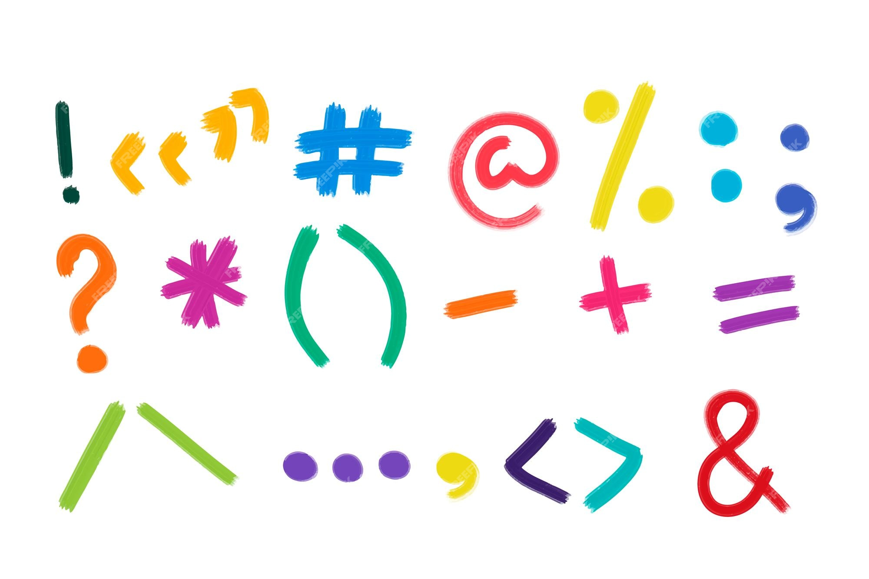
WHAT ARE PUNTUATION MARKS?
It refers to the use of symbols in written language to clarify meaning and indicate pauses, stops, or other grammatical elements. Punctuation marks include symbols.

Slide 5
CAPITALIZATION
Capitalization is the process of capitalizing the words necessary to make sentences understandable.

Slide 6
RULES OF Capitalizations
Always Capitalize the First Word of a Sentence.
Examples:
The man worked late last night.
Why are you looking at me?
Lets go to the cinema.
2.Capitalize names and other proper noun.
Examples:
She lives in Pakistan.
Do you have to work on Friday?

Slide 7
RULES OF Capitalizations
3. Capitalize the first word of a quote when the quote is a complete sentence.
Example:
"He can't go. He's busy that night," Mary replied.
4. Capitalize the most words in tittle.
The capitalization rules for titles of books,movies and other words can change depending on style guides
Example :
My favorite show is Games of Thrones

Slide 8
RULES OF Capitalization
5. Always capitalize the pronoun “I ”.
Ali is going to order fish , and I am going to order steak.
6. Capitalize the Official Title of a Person When Used With That Person's Name.
Examples:
"I think Dr. Smith is really friendly and professional." "Yes, she is a great doctor!"

Slide 9
TYPES OF PUNTUATION MARKS
PERIODM
QUESTION MARK
EXCLAMATION
MARK
COMMA
COLON
SEMI COLON
DASH
HYPHEN
BRACKETS
APOSTROPHE
QUOTATION MARKS
ELLIPSIS

Slide 10

PERIOD
It is also referred to as a full stop, the period denotes the end of a sentence. A full sentence is considered as one that is complete and declarative.
Here’s an example of a period at the end of a sentence:
I like dogs.
He drinks coffee.
Periods are also used in abbreviations, such as in names or titles.
Here are examples of how to use a period in abbreviations:
Dr. Smith read his patient’s chart.
Mr. H. Potter opened his front door.

Slide 11

QUESTION MARKS
A question mark also ends a sentence, however it ends a sentence that is a direct question. Typically, sentences that are questions begin with what, how, when, where, why, or who.
Here’s how to use a question mark in a sentence:
How do you like your eggs?
Where were you going last night?
Generally, a question mark also denotes a shift in tone in a sentence if it’s being read out loud, so this is something to take note of.

Slide 12

EXCLAMOTRY MARKS
An exclamation mark is also used at the end of a sentence when that sentence expresses an intense emotion. The expression can be a variety of things, from excitement, disgust, anger, joy, or anything else. Exclamation points are meant to add emphasis to a sentence.
Here’s how to use one in a sentence:
“Look out behind you!” she yelled.
I’m so excited to go to the park tomorrow!

Slide 13
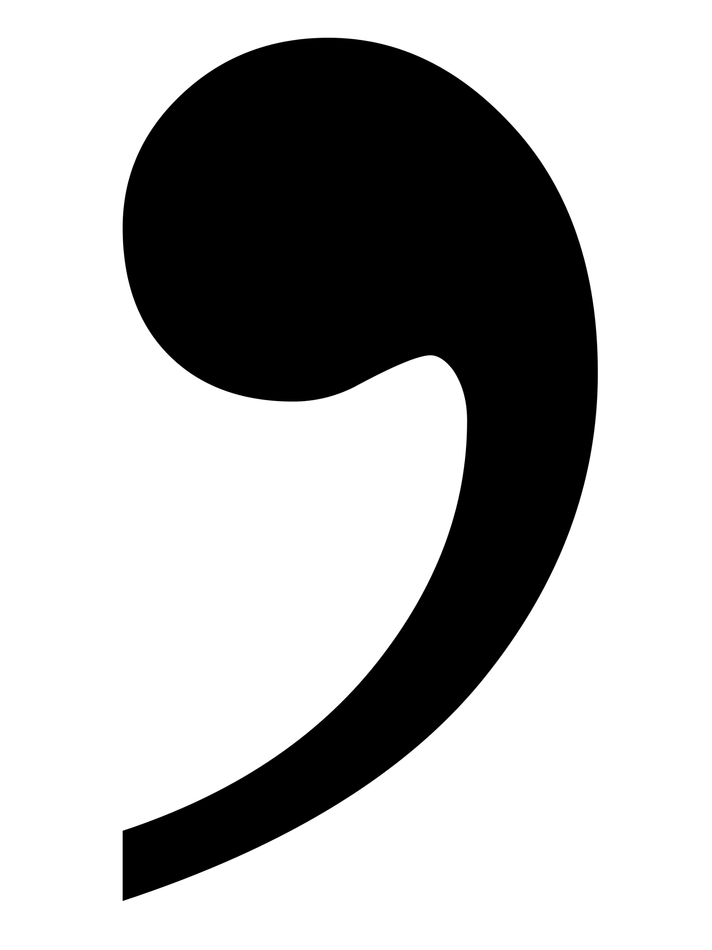
COMMA
Commas are used to insert a pause into a sentence. The purpose of the pause can be for different reasons, such as to separate ideas, phrases, or even alter the structure of a sentence.
Commas have a few different uses. Commas are used for a direct address, such as:
Joe, it was nice to see you again.
We saw Marry and Peter at the park.
They’re also used to separate two complete sentences:
He went to the library, and then he went out for lunch.
Commas can also be used to list items in a sentence:
She went shopping and bought shoes, a dress, two shirts, and a pair of pants.

Slide 14
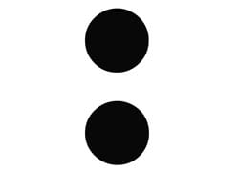
COLON
A colon has three primary uses. One way to use it is when introducing something, such as a quote, an example, a series, or an explanation.
She took four classes last semester: history, biology, arts, and economics.
A colon can also be used to link two independent clauses if the second clause clarifies or completes the first one.
For example:
They didn’t have time to waste: it was already late.
Finally, a colon can also emphasize a subject in a sentence:
I only hate one vegetable: Radish

Slide 15
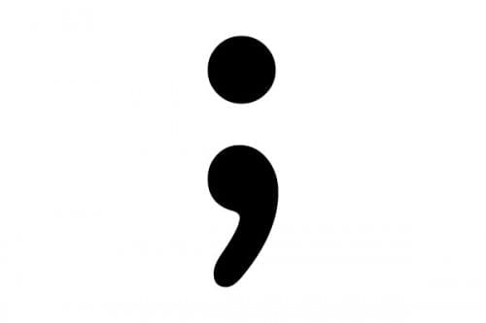
SEMI COLON
Similar to a colon, a semicolon links two independent clauses. However, in this case, the clauses are more closely related than when you would use a colon.
For example:
I have a meeting tomorrow morning; I can’t go out tonight.
Both clauses are independent enough to be their own sentences, but instead of using a period, it’s possible to use a semicolon to show both clauses are connected.
Another less common use for semicolons is within a list that uses commas. Have a look:
Last summer we traveled to London, England; Paris, France; Rome, Italy; and Athens, Greece

Slide 16
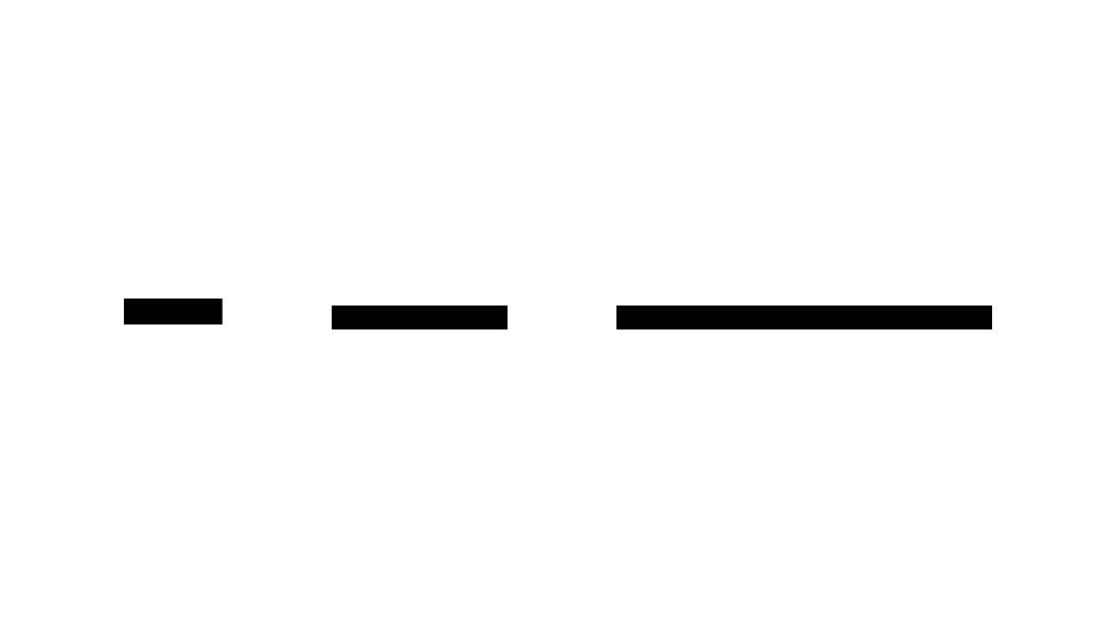
DASH
There are two types of dashes that vary in size and use.
En dash: Typically shorter in length, the en dash is used to denote a range, such as between numbers or dates.
For example:
The company was operational from 1990-2000.
He took the Chicago-New York train last night.
Em dash: this dash is longer, and is sometimes used instead of other punctuation marks, like commas, colons, or parentheses.
For example:
Her answer was clear — Yes!

Slide 17
HYPHEN
Not to be confused with a dash, a hyphen is used in compound words when two or more words are connected.
Here are some examples of hyphenated words:
Step-by-step
Mother-in-law
Ex-boyfriend

Slide 18
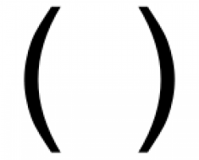
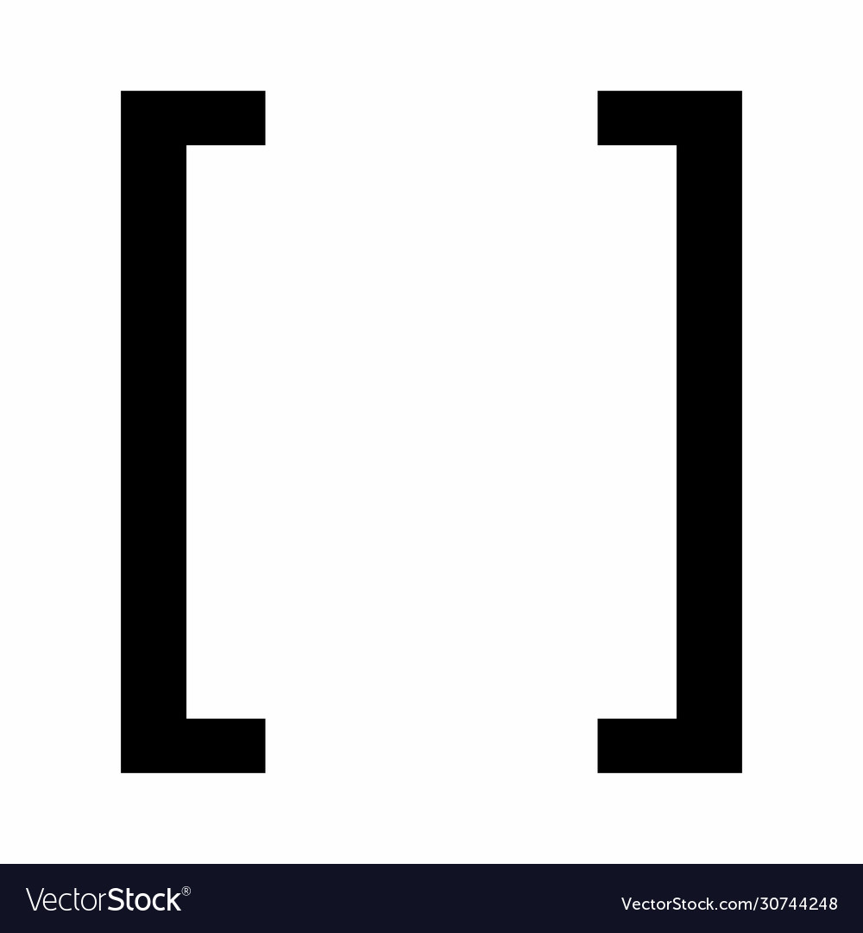
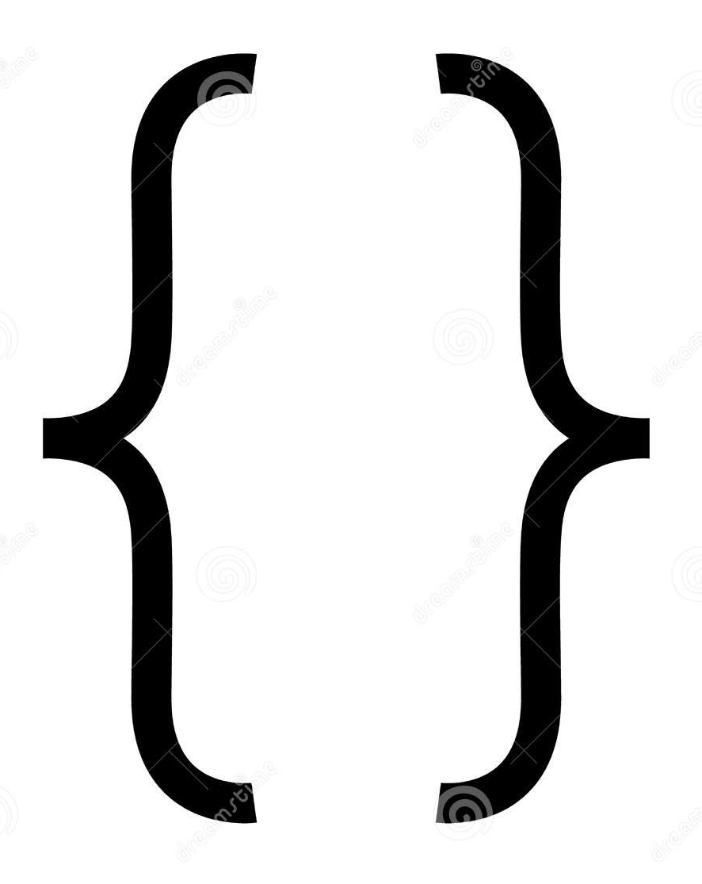
BRACKETS
Parentheses (( ))
Parentheses are used to supply further details or information or as an aside. Parentheses can often be replaced with commas and the sentence would retain its same meaning.
Here’s an example:
Kate (who is Matt’s wife) likes to go for walks.

Slide 19
BRACKETS
Brackets are used to clarify something or for technical terms or explanations. It can also be used to clarify a subject when quoting another person or text.
For example:
She [Mrs. Smith] agrees that cats are better than dogs.
Adam said that “[summer] is my favorite time of year

Slide 20
BRACES
It’s unlikely you’ll need to use braces very often unless you’re writing a mathematical or technical text. However, it’s still good to know so you don’t accidentally use them instead of brackets or parentheses. Braces are usually used in operations.
for example:
6{3x+[28+2]}=xy
3+(-5)=-2

Slide 21
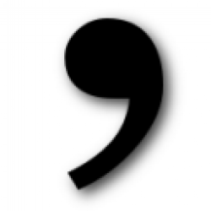
APOSTROPHE
Apostrophes are meant to show that a letter or letters have been omitted and also to indicate the possessive or contractions. It can also be used to pluralize lowercase letters.
Here are some examples:
I’ve been working from home for 6 months and it’s great.
Rebecca’s dog had surgery yesterday.
All that’s left to do is dot the i’s and cross the t’s.

Slide 22
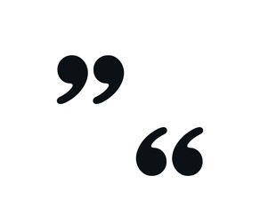
QUOTATION MARKS
Quotation marks are used to denote text, speech, or words spoken by someone else. It is also used to indicate dialogue.
For example:
“I don’t like this,” said Mark.
Mr Ahmed said,"The shops are closed."
Single quotation marks (‘ ’), not to be confused with apostrophes, are often used for a quote within a quote.
Jill told her mother “Jack ran up the hill and he said he was going to ‘fetch a pail of water’ before he fell.”

Slide 23

ELLIPSIS
An ellipsis is three periods used together to represent an omission of words or letters. They are often used to jump from one sentence or phrase to another while omitting unnecessary or obvious words. It’s also used when quoting someone and unnecessary words are left out.
Here are some examples:
At midnight, she began to count down: “ten, nine, eight…” and then the ball dropped.
Sam said to Tom,"I am very sorry...l hope you can forgive me."

Slide 24
Why Are They Important?
Punctuation helps to clarify the meaning of a sentence
Punctuation contributes to the tone and emotion of a written piece. For example, the use of exclamation marks can convey excitement or emphasis, while a series of ellipses may suggest a trailing off or a sense of hesitation.
Punctuation is essential for maintaining proper grammar and syntax.

Slide 25
Why Are They Important?
Punctuation marks like commas, semicolons, and colons are used to separate different ideas, elements, or items in a sentence
Punctuation is crucial when presenting direct speech or quotations. It helps to distinguish between the speaker's words and the rest of the text, guiding readers on when a new person is speaking.

Slide 26
Power of punctuation
The power of punctuation lies in its ability to transform the meaning of a sentence and shape the way it is interpreted.
Lets Consider the difference in meaning between
"Let's eat, Grandma!" and "Let's eat Grandma!“
The placement of the comma completely changes the message, illustrating how punctuation can be powerful in conveying nuances, preventing misunderstandings, and influencing the overall impact of written communication.
In creative writing, punctuation is a tool that writers can use to control the rhythm, pace, and emphasis in their work. It allows for the creation of suspense, drama, or humor. A well-placed ellipsis, for instance, can create a sense of anticipation, while a well-timed exclamation mark can add emphasis and excitement

Slide 27
Power of punctuation
An English professor wrote the words:
"A woman without her man is nothing“
on the chalkboard and asked the students to punctuate it correctly.
All of the males in the class wrote:
"A woman, without her man, is nothing.“
All of the females in the class wrote:
"A woman: without her, man is nothing.
Punctuation is powerful

Slide 28
THANK YOU

Slide 29

ANY QUESTION ?

